Slide 1
AngularJS Unit Testing
Controllers, Services, Directives

Slide 2
Thanks
Ben Lesh
http://www.benlesh.com/search/label/Unit%20Testing
Darren Nelsen

Slide 3
Who is this guy?
Kenn Brodhagen
kennbrodhagen@gmail.com
@kennbrodhagen
http://hipsware.com
Background in real-time telephony recorders
Recent move to front-end with Angular

Slide 4
We’ll talk about…
AngularJS Unit Testing background
Modules, injectors
Spies
httpBackend
Examples & Techniques for unit testing
Controllers
Services
Directives

Slide 5
Unit Test background
Karma
Test runner
http://karma-runner.github.io/0.10/index.html
Jasmine
Test Framework
http://pivotal.github.io/jasmine/
describe/it style like rspec
expect(x).toEqual(y) assertion style

Slide 6
Inject
// Provide access to angular and user services in your test.
it(‘gets access to services with inject’, inject(function($window){
$window.doSomething();
// also works standalone
inject(function($q) {
$q.when(‘bar’);
});
});

Slide 7
Module
// Triggers re-creation of all controllers, services directives
// Place to mock services used by the service you are
// testing.
beforeEach(module(‘githubViewApp’));
module(‘githubViewApp’, function($provide) {
$provide.value(‘x’, mockX);
});

Slide 8
Spies
callback =
jasmine.createSpy(‘callback’);
foo(callback);
expect(callback).toHaveBeenCalled();

Slide 9
httpBackend
httpBackend
.expectGET(‘/foo/bar’)
.respond(200, {foo: bar});
someServiceCall();
httpBackend.flush();
expect(…);

Slide 10
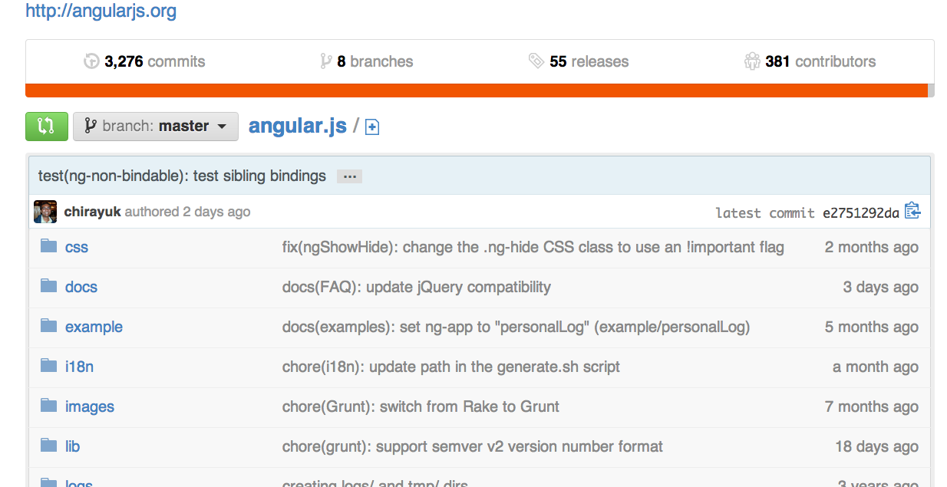
Example Problem: Github API

Slide 11
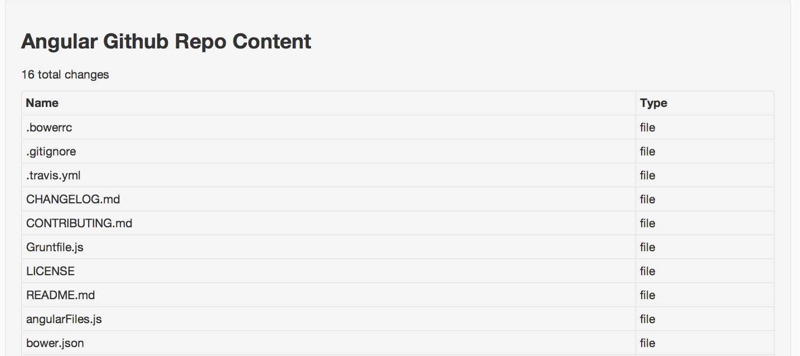
Example Problem: Github API

Slide 12
Github API
https://api.github.com/repos/angular/angular.js/contents/
[ {
"name": ”foo.txt”,
"url": "https://api.github.com/…/foo.txt",
"type": "file",
}]

Slide 13
Example Solution
Component | Responsibility
angularRepo Service | http interface Business objects
AngularRepoCtrl Controller | Wire up data service to directive & view.
githubRepoView Directive | Layout & Display Hooks for clicking dir, content

Slide 14
Business Objects
Item
+contents(): Promise of Item array
+name: Name of file or directory
+type: ‘dir’ or ‘file’
angularRepo
+refresh(callback) +rootItem(): Item

Slide 15
View the markup
<div class="well">
<h3>Angular Github Repo Content</h3>
<p>{{repoChanges}} total changes</p>
<github-repo-view
action="viewContent”
content="repoContent"/>
</div>

Slide 16
Testing the Controller
Responsibilities
Load content from services
Handle event when dir is clicked to load contents for dir.
Setup refresh
Count refreshes

Slide 17
Testing the Controller
Tactics
Mock angularRepo service
Inject scope & mock via $controller()
Use $apply() to test watches

Slide 18
Testing the Service
Responsibilities
HTTP interface
Object model – Item
refresh

Slide 19
Testing the Service
Tactics
module/$provide to mock $timeout service
inject to acquire httpBackend

Slide 20
Testing the Directive
Responsibilities
Table of items
Anchor/onClick for dir type items
content & action properties to link to controller

Slide 21
Testing the Directive
Tactics
$compile/$digest to build the DOM element
Selectors to locate items in DOM to test

Slide 22
Links
Code & PPT
https://github.com/kennbrodhagen/angular-github-view
Jasmine
http://pivotal.github.io/jasmine/
Karma
http://karma-runner.github.io/0.10/index.html
Ben’s Blog Post
http://www.benlesh.com/search/label/Unit%20Testing
Github API
http://developer.github.com/v3/repos/contents/

